Slide 1
Car Safety Systems

Slide 2
By the end of this Smart Lesson, you should be able to explain how the following car safety systems use the laws of physics to protect passengers during car crashes:
Seatbelts
Headrests
Crumple zones
Airbags

Slide 3
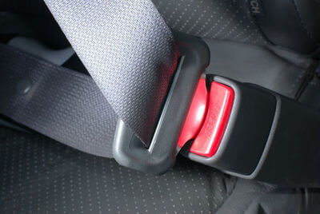
We will start by looking at seatbelts.
Seatbelts make sure that the passenger stops moving when the car stops moving.
If the passenger wasn't wearing their seatbelt and the car stopped suddenly, the passenger would keep moving forward and could get very badly hurt.

Slide 4
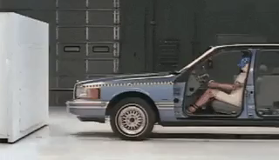
The Purpose of a Seatbelt:
The passenger continues moving forward when the car stops because of their inertia. When the passenger hits the seatbelt as they move forward, they exert a force on the seatbelt.
If they were not wearing a seatbelt, they would keep moving forward. This is because there is no force acting on them to change their motion.

Slide 5
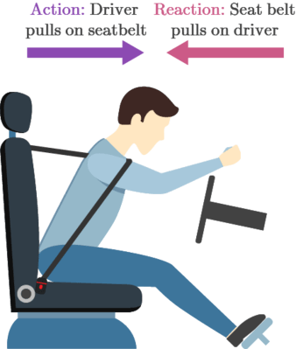
According to Newton's Third Law, this means that the seatbelt must apply a reaction force to the passenger.
This force from the seatbelt overcomes the inertia of the passenger, making them stop with the car.

Slide 6
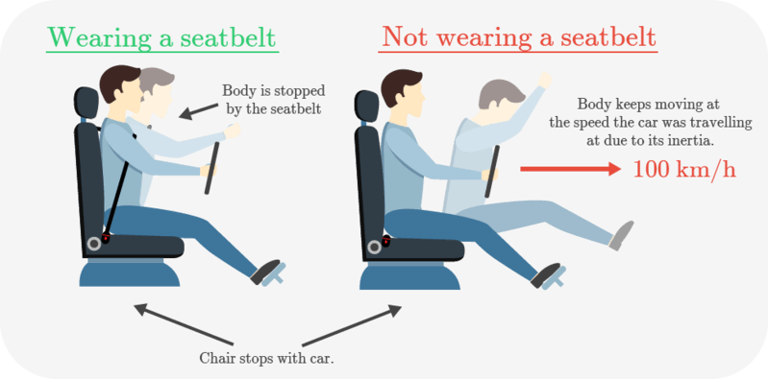
This diagram shows how seatbelts make the passenger stop when the car stops.

Slide 7
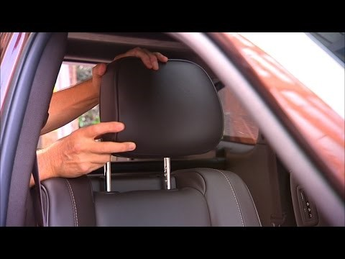
Headrests are another very important safety feature in cars which prevent head and neck damage.

Slide 8
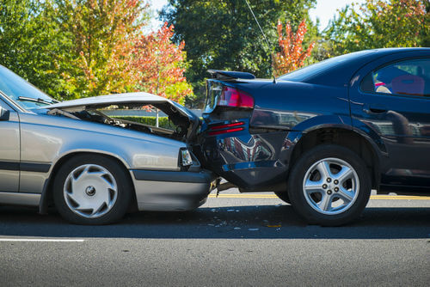
When a car is hit from behind, the passenger's body is pushed forward by the seat.
However, due to the passenger's inertia, their head remains in the same place. This makes it feel like it is being snapped back, a nasty condition known as whiplash.

Slide 9
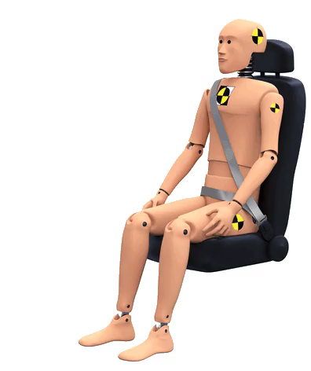
The headrest applies a force to the passenger's head as the car moves forward. It overcomes the inertia of their head.
This means the passenger's head moves forward as their body moves forward, preventing whiplash. Hooray!

Slide 10
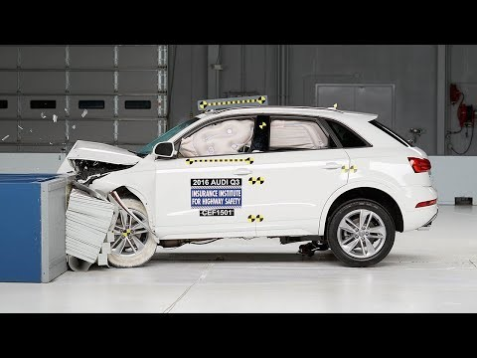
Crumple zones are special sections on cars designed to crumple in a collision.
Watch this video (0:44) to see a crumple zone in action! As the car hits the barrier, you can see that the front of the car is crumpled, while the section the passenger sits in keeps its shape.

Slide 11
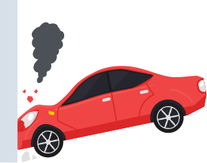
When a crumple zone is crushed in a collision, it absorbs some of the energy transferred to the car in the collision.
This means that less energy is transferred to the people in the car. As a result the passengers are not hurt as badly as they could have been.

Slide 12

Crumple zones are usually found on the front of cars.
Some modern cars have crumple zones on the sides or at the back as well, but these are less common.

Slide 13
The section of the car that people sit in is made from sturdy material which does not crumple.
This is called the passenger cell.
People in the passenger cell are not hurt as the crumple zones are crushed.

Slide 14
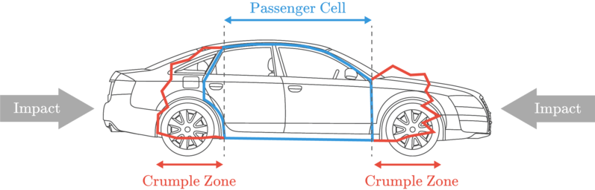
In the first diagram, the car has crumple zones which prevent the passenger cell (blue box) from being crushed.

Slide 15
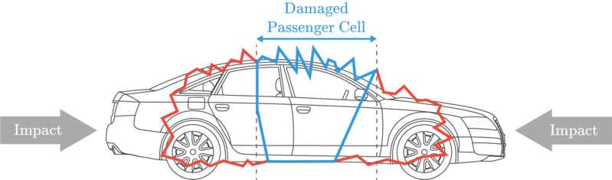
In the second diagram, the car has no crumple zones and the passenger cell is badly deformed!

Slide 16
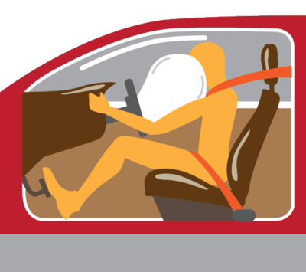
Airbags are cushions that can be quickly inflated by gases in the event of a collision.
They are usually located between the passenger and the steering wheel or dashboard. Some cars also have side airbags.

Slide 17
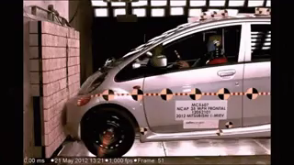
Airbags work with seatbelts to hold the passenger's head in place during a collision.
Seatbelts hold passengers at the shoulders and hips, but they don't restrain the head.
This is why it's important to have both seatbelts and airbags in modern cars.

Slide 18
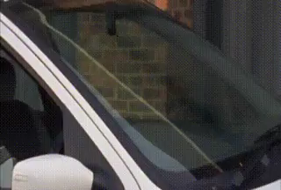
When an airbag is used, the passenger's head moves forward more slowly as the airbag pushes back on it with a force.
This also prevents the head from hitting the dashboard and bouncing back off it, a phenomenon called recoil.

Slide 19
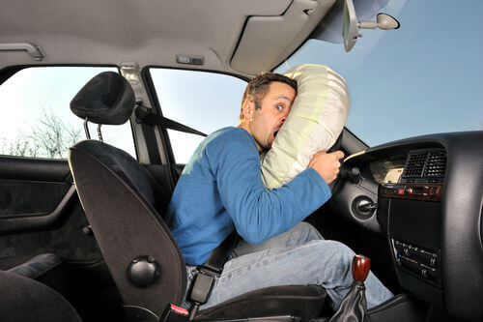
Airbags absorb energy from the passenger's head as it quickly moves forward.
Without an airbag, the head would hit the hard dashboard or steering wheel instead. Ouch!

Slide 20
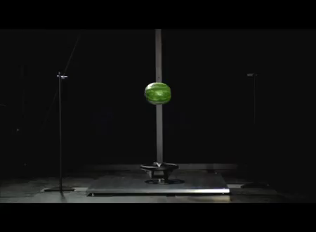
It is very important that the airbags are deployed (inflated) as soon as a collision occurs.
An automatic process monitors the braking acceleration of the car. If the car slows down extremely quickly, the car detects a rapid deceleration and the airbags are deployed.
It takes about 50 milliseconds (50 ms) for the airbags to be deployed after a collision occurs.

